Slide 1
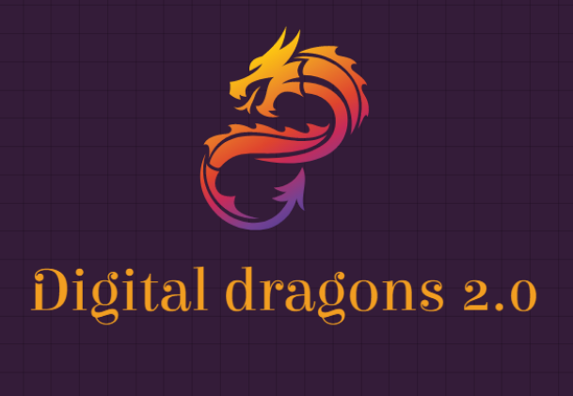
B-CARE
An ingenious solution that will help users in early diagnosis of Breast Cancer with the help of Machine Learning.

Slide 2

Problem Statement
Breast cancer is the most common form of cancer women across the world, including in India. In fact, breast cancer accounts for a third of all the cancers that affect women in the country. Unfortunately, the prevalence of taboo and lack of awareness results in late presentation of the disease. According to an ICMR study, the age-standardised rate of breast cancer is approximately 25.8 per one lakh women and is expected to rise to 35 per one lakh women by 2026. Early diagnosis of breast cancer accounts for only 30% of all reported cases in India, compared to 70% in the developed world and 70% of patients are diagnosed with cancer when the disease is far too advanced (stage 3 or 4).

Slide 3
Why B-Care???
Breast cancer is a taboo in our society and even in other developed countries. An application like this can help people in early diagnosis even if they are shy to reach out to a doctor.
A simple yet powerful application where user is been provided with several essential features like Calculating Risk, Exercise with goals and reminders, motivation, Awareness page and Real time data analysis
We live in a technology centric world and therefore more awareness can be created to general public with help of these technologies.

Slide 4
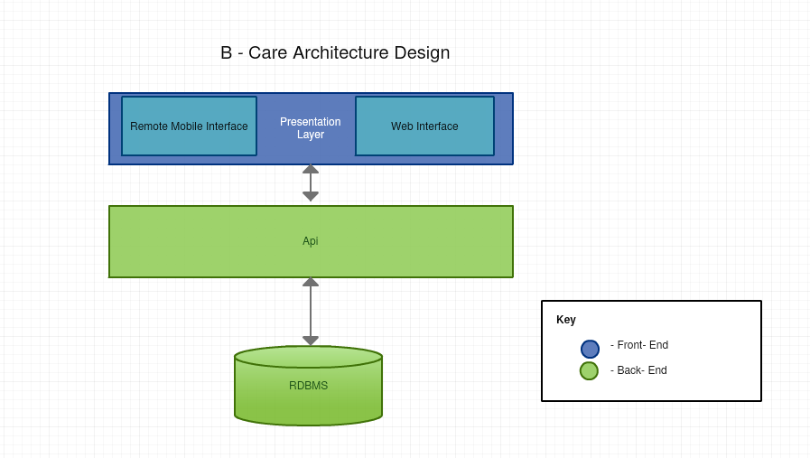



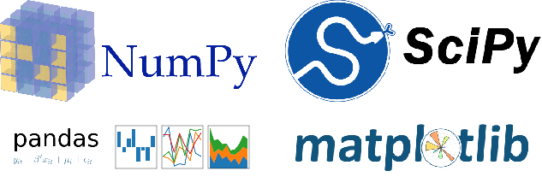
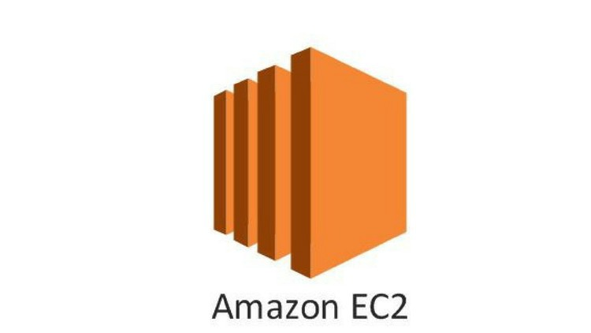


(Cordova)
(Angular)
Python Flask Framework

Slide 5


ML DATA & ALGORITHMS

Slide 6

Clustering
CLUSTERING
We are using K-nearest neighbor algorithm for finding clusters for a particular user.
It belongs to supervised learning domain and used for pattern recognition and data mining.
As K-nearest neighbor algorithm works well with smaller data sets and it is easy to implement over other algorithms, we went with K-nearest neighbor over other algorithms.
We are using numpy, pandas, sklearn and matplotlib for model training in K-nearest neighbor .

Slide 7
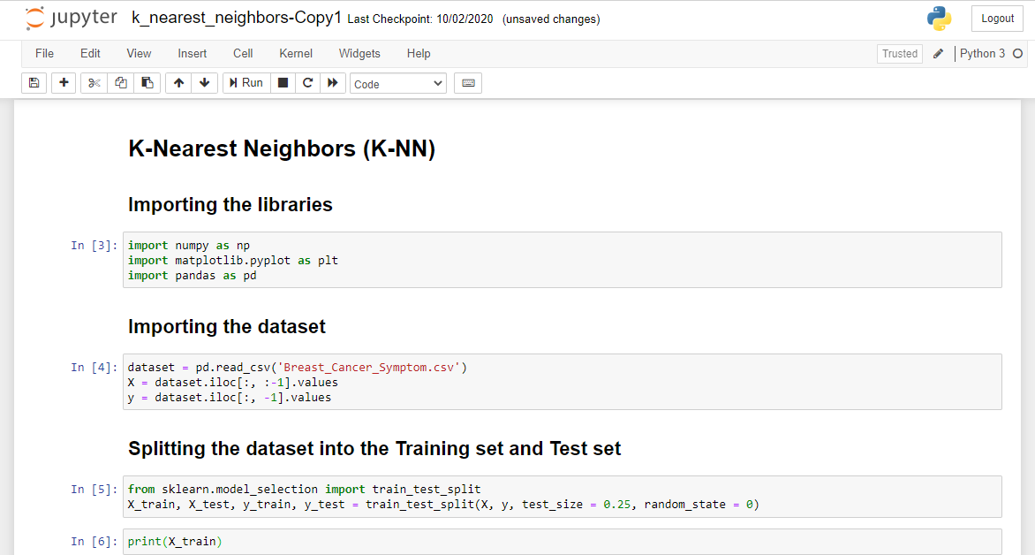

Slide 8
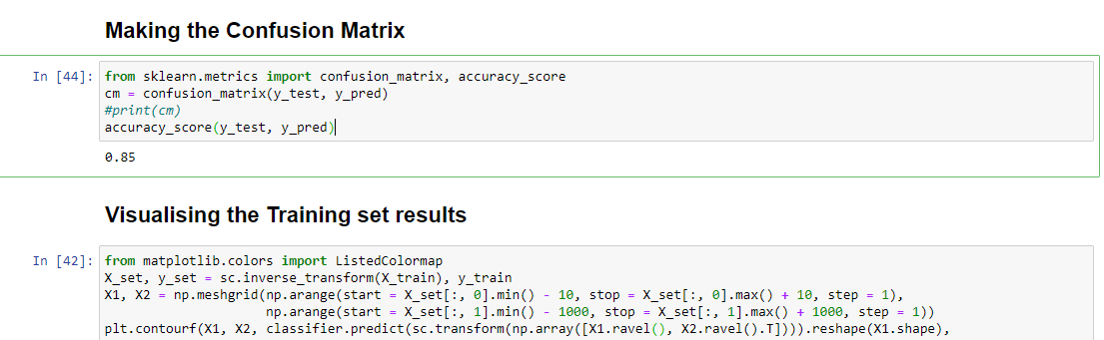

Slide 9
Classification Of Clusters
The users are split in to various clusters once they take Quick checkup.
Clustering is done based on their symptoms shown and age group they belong.
The clustering of users in such groups helps to provide them with cluster specific treatment details and helps in suggesting exercises.

Slide 10
Quick Checkup Criteria Selection
The inputs we are getting from user in Quick checkup functionality is based on Risk Factors. Few of them are
Radiation exposure: Women who, as children or young adults, had radiation therapy to the chest area as treatment for another cancer have a significantly increased risk for breast cancer.
Menstrual history: Women who start menstruation at an early age (before age 12) and/or menopause at an older age (after age 55) have a slightly higher risk of breast cancer. The increase in risk may be due to a longer lifetime exposure to the hormones estrogen and progesterone.
Family history: Having a family history of breast cancer, particularly women with a mother, sister or daughter who has or had breast cancer, may double the risk.
Personal history of breast cancer :Women who have had breast cancer are more likely to get breast cancer a second time. Some non-cancerous breast diseases are associated with a higher risk of getting breast cancer.
Reproductive history: Having the first pregnancy after age 30, not breastfeeding, and never having a full-term pregnancy can raise breast cancer risk.
Hormonal Use: Some forms of hormone replacement therapy taken during menopause can raise risk for breast cancer when taken for more than five years. Certain birth control pills also have been found to raise breast cancer risk.
Drinking alcohol. Studies show that a woman’s risk for breast cancer increases with the more alcohol she drinks.
Personal history of breast cancer :Women who have had breast cancer are more likely to get breast cancer a second time. Some non-cancerous breast diseases are associated with a higher risk of getting breast cancer.

Slide 11

Risk prediction
RISK PREDICTION
Multiple Linear regression was used for risk prediction.
Regression analysis is a predictive modelling technique that analyzes the relation between the target or dependent variable and independent variable in a dataset.
Multiple Linear Regression takes more than one predictor variable to predict the response variable.
We are using numpy, pandas, sklearn and matplotlib for model training in multiple linear regression.

Slide 12
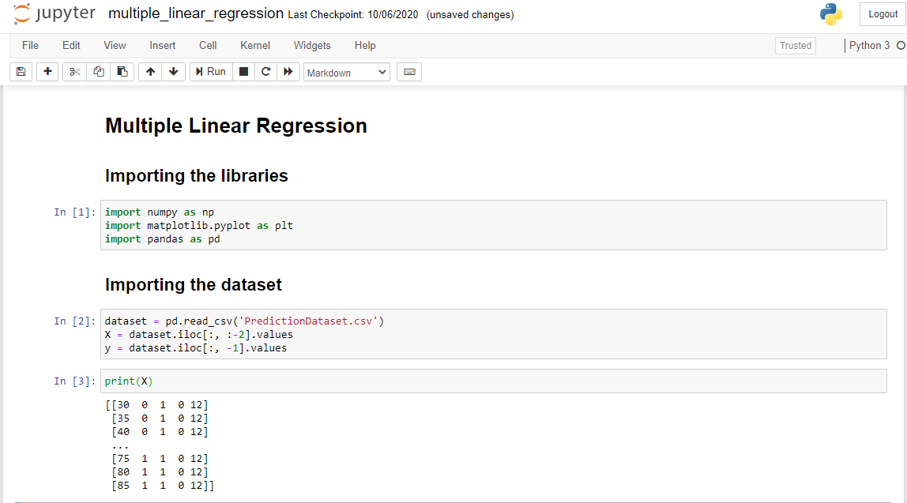

Slide 13
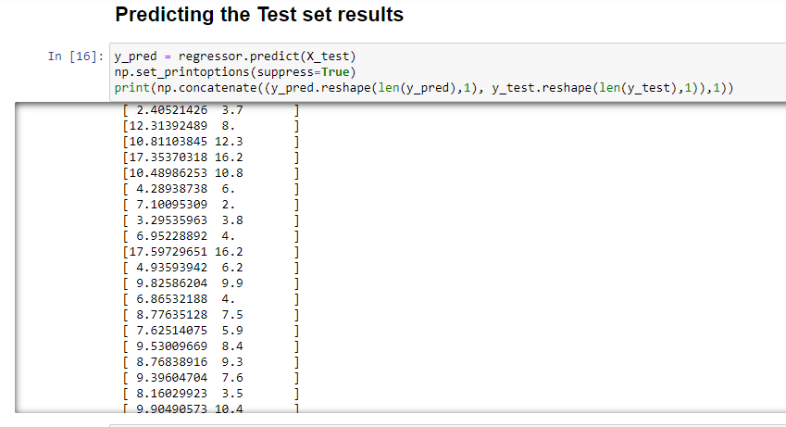

Slide 14
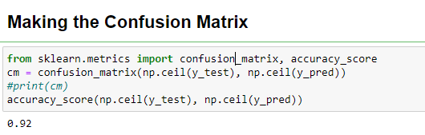

Slide 15

Currently the features we are suggesting user includes only exercises. Along with it we have also planned to include Diet plans for each cluster.
Accommodating Doctors into our Platform.
Addition of a video call feature for doctor and patient to interact.
Creating a discussion forum for people to interact with each other.

Slide 16
Scalability, Usability, Advantages & Business value
Dataset used in prediction can be increased to a larger extent so as to obtain much better and accurate results.
It is more socially feasible and easy to use considering the application is designed keeping the common people as users in mind and how useful it can be for the general public.
Early detection will help reduce deaths due to breast cancer and will create awareness among general public.
Coming to the point of cost factors since we are using open-source technologies it is also economically feasible.
Once we develop it as a mobile application, we can target way more audience using mobile as you know everyone has mobile nowadays.
Infosys Foundation has programs in the areas of healthcare this application will make a difference in health care.

Slide 17
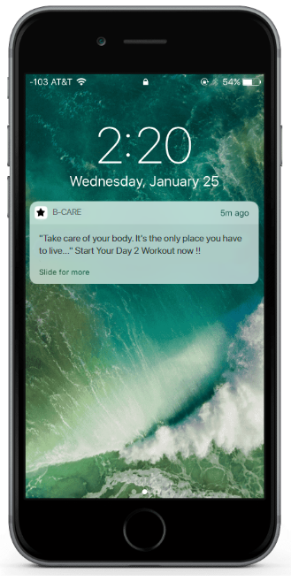
Mobile Reminder Notification

Slide 18
Code URL-
Python API [ML], Test Cases & Postman Collection-https://github.com/vijayjeyakumar/BreastCancerSolutionAPI
Angular UI Code- https://github.com/Suhabavan/BCareSolution/

Slide 19


